Slide 1
Operation manual (1)
Dr .Arash kazemi veisari
EUS fellow

Slide 2
Basics of Ultrasound Instrumentation
The key component of an ultrasound system is the transducer. A transducer is a device that converts one form of energy to another. In the case of ultrasound transducers, electrical energy is converted to mechanical energy, resulting in the transmission of an ultrasound pulse.

Slide 3
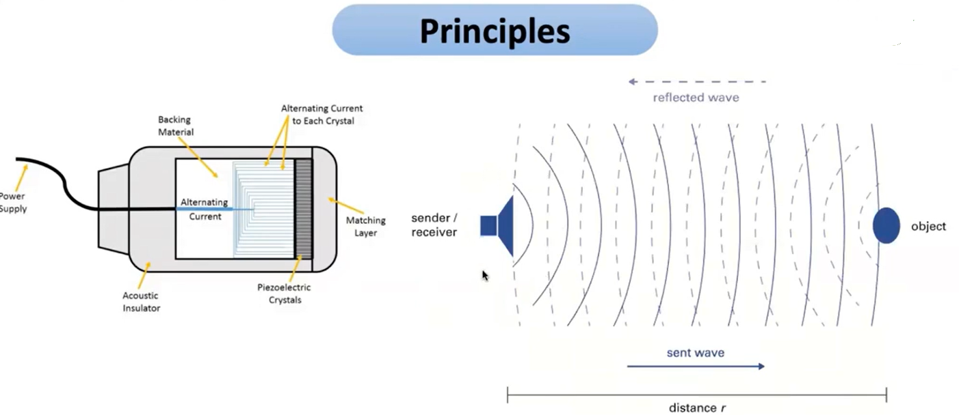

Slide 4
When an ultrasound signal is then received by the ultrasound transducer, the received mechanical signal is converted back to an electrical signal that is then processed and digitized by the ultrasound processor to yield a real-time image of the tissue being interrogated by the ultrasound transducer.

Slide 5
The signal can then undergo time gain compensation (TGC), and the subsequent output will be the A-mode line scan. After TGC, the signal is further processed, including demodulation and registration, to yield a B-mode image.

Slide 6
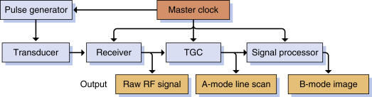

Slide 7
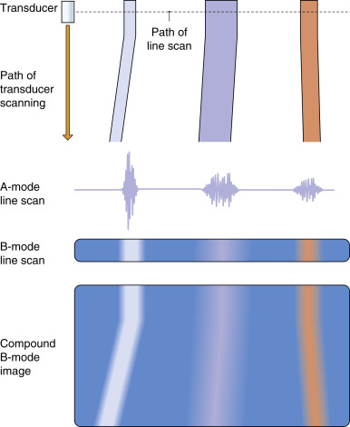

Slide 8
Ultrasound Interactions in Tissue
A propagating ultrasound wave can interact with tissue, and the results are reflection, refraction, scattering, and absorption.

Slide 9
Reflection
Sound will continue to propagate through a medium until an interface is reached where the acoustic impedance of the medium in which the sound is propagating differs from the medium that it encounters.

Slide 10
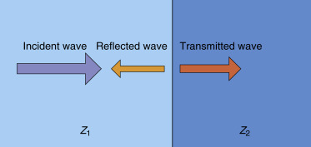

Slide 11
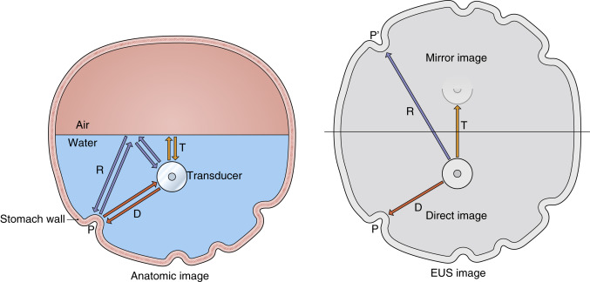

Slide 12
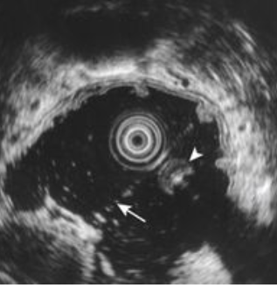
Reflection (Mirror Image)

Slide 13
The percentage of the incident beam that is transmitted is as follows:
% transmitted = 100 − % reflected

Slide 14
Refraction
When the incident beam arrives at the interface at an angle other than 90 degrees, the transmitted beam path diverges from the incident beam path because of refraction.

Slide 15
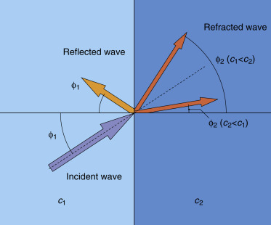

Slide 16
Refraction of the ultrasound beam can lead to imaging artifacts.

Slide 17
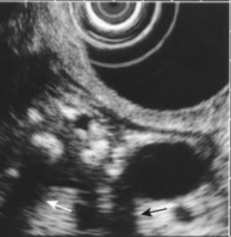
Acoustic Shadowing

Slide 18
Scattering
Scattering, also termed nonspecular reflection, occurs when a propagating ultrasound wave interacts with different components in tissue that are smaller than the wavelength and have different impedance values than the propagating medium.

Slide 19
Examples of scatterers in tissue include individual cells, fat globules, and collagen. When an ultrasound wave interacts with a scatterer, only a small portion of the acoustic intensity that reflects off of the scatterer is reflected back to the transducer.

Slide 20
Scattering occurs in heterogeneous media, such as tissue, and is responsible for the different echotextures of organs such as the liver, pancreas, and spleen.

Slide 21
Tissue containing fat or collagen scatters ultrasound to a greater degree than do other tissues, and this is why lipomas and the submucosal layer of the gastrointestinal (GI) tract appear hyperechoic (bright) on ultrasound imaging.

Slide 22
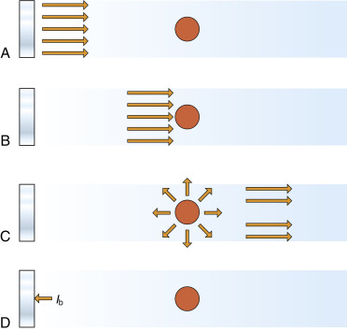

Slide 23
The noise resulting from acoustic speckle increases with increasing depth as a result of the greater number of signals that have undergone multiple reflections from nonspecular reflectors returning to the transducer.

Slide 24
Absorption
The absorption of ultrasound energy depends on tissue properties and is highly frequency dependent. Higher frequencies cause more tissue vibration and result in greater absorption of the ultrasound energy and more heat generation.

Slide 25
Ultrasound Intensity
As ultrasound waves propagate through tissue, the intensity of the wave becomes attenuated.
Attenuation is the result of effects of both scattering and absorption of the ultrasound wave.

Slide 26
The frequency of the ultrasound pulse affects both the depth of penetration of the pulse and the obtainable resolution.

Slide 27
In general, as the frequency is increased, the depth of penetration decreases, owing to attenuation of the ultrasound intensity, and axial resolution improves.

Slide 28
Axial Resolution
Axial resolution refers to the smallest separation distance between two objects along the beam path that can be detected by the imaging system. Axial resolution is determined by the ultrasound frequency and the spatial pulse length (SPL) of the transmitted ultrasound pulse.

Slide 29
SPL(spatial pulse length (SPL) of the transmitted ultrasound pulse) = c f × n
c is the speed of sound in tissue, f is the center frequency of the transmitted ultrasound pulse, and n is the number of cycles per pulse (typically four to seven cycles).
Axial resolution is the most important property in imaging the layered structures of the GI tract wall.

Slide 30
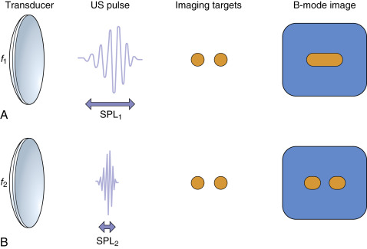

Slide 31
Lateral Resolution
The lateral resolution of an imaging system represents the ability to discriminate between two points that are in a plane perpendicular to the ultrasound beam.
The beam width of the transducer determines the achievable lateral resolution and is a function of transducer size, shape, frequency, and focusing.

Slide 32
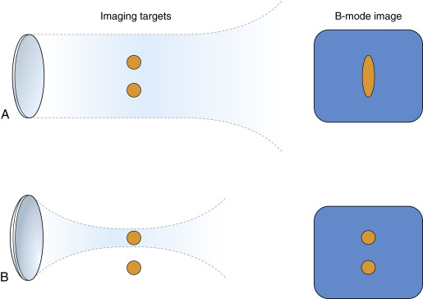

Slide 33
IMAGE OPTIMIZATION DURING B-MODE AND DOPPLER ULTRASOUND IMAGING
How to use echoendoscope to optimize your image apposition?

Slide 34
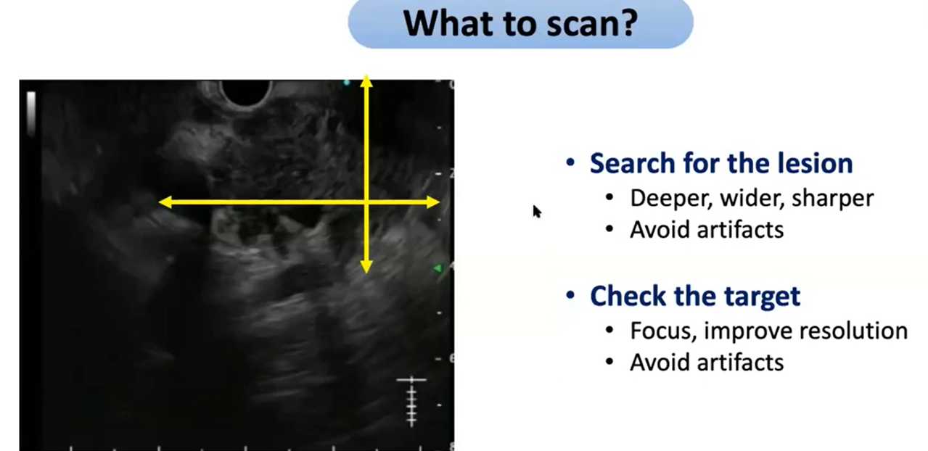

Slide 35
OPTIMIZATION OF B-MODE IMAGING
at first Do a survey scan with perform a general investigation of the structures and organs of interest.
Then image optimization can be conducted in a targeted manner.

Slide 36
The first step requires proper adjustment of the B-Mode image. Subsequently, the examiner uses color flow imaging in the region of interest (ROI). Lastly, spectral Doppler imaging is conducted in a small examination area, named “sample volume (SV)” or “gate,” that features a vessel of interest.

Slide 37
Adjust the image depth
To adjust the image depth, the user displays the structures of interest as large as possible on the screen (i.e., the object “fills” the screen).

Slide 38
The user should also aim for the lowest achievable depth setting. Excessive depth decreases the frame rate and temporal resolution.

Slide 39
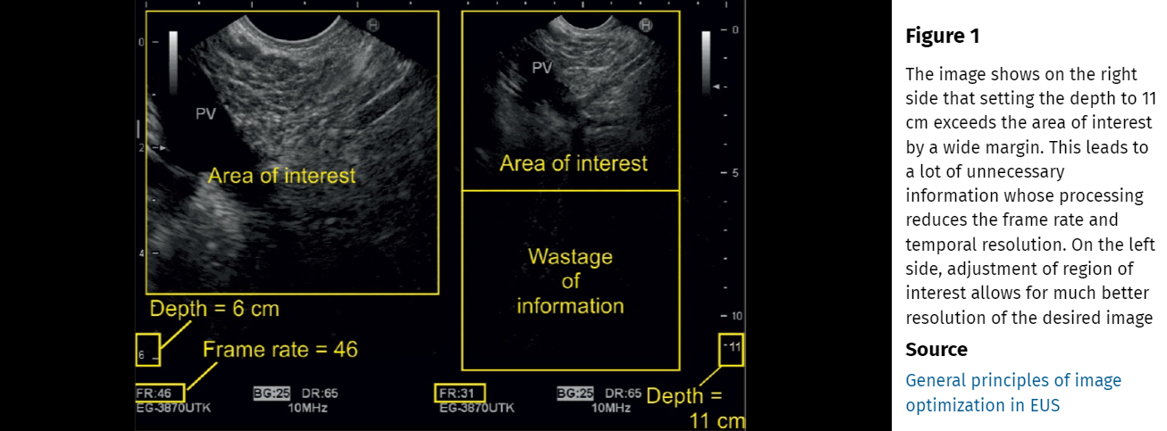

Slide 40
If remote structures need to be examined, use of the zoom function reduces the size of the ROI and improves the frame rate and temporal resolution during B-mode imaging.
In general, we move from “overview” with certain settings to more precise imaging, which requires specific modifications.

Slide 41
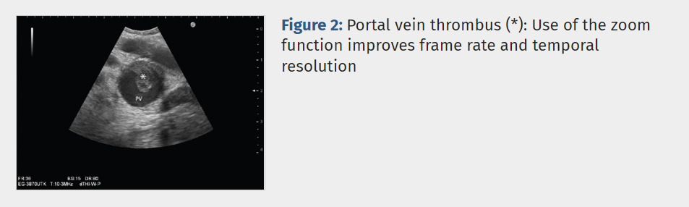

Slide 42
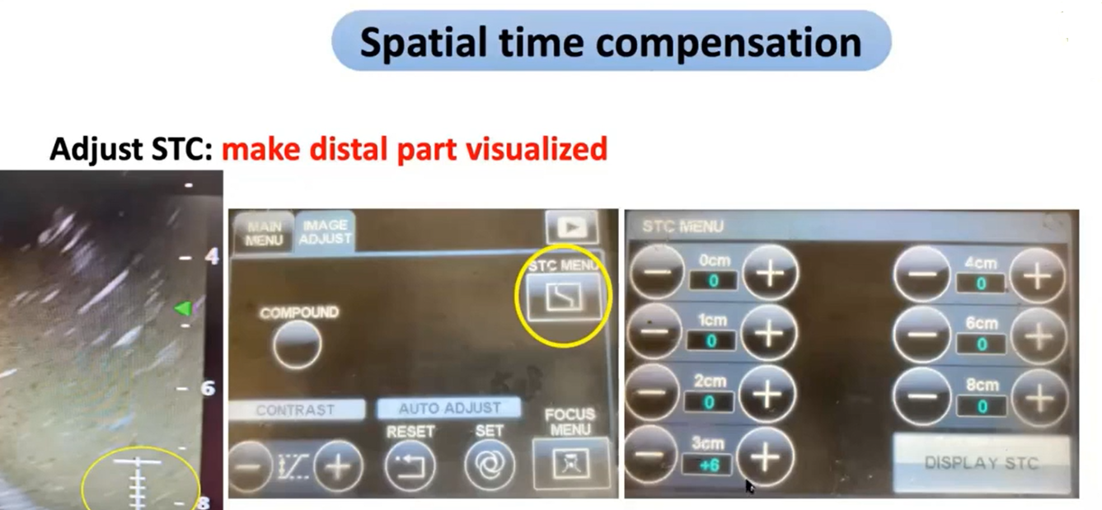

Slide 43
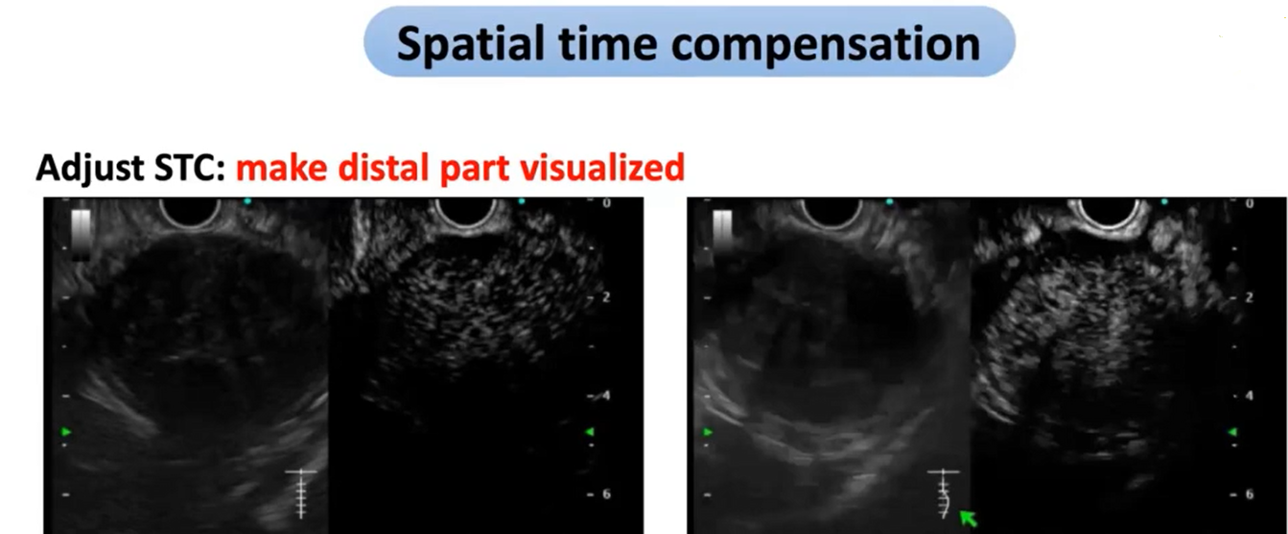

Slide 44
Adjust the transducer frequency
EUS focuses on specific questions Thus, overview is no real indication.
The examiner should use the lowest transducer frequency possible if maximal penetration is required. Higher frequencies are useful if high spatial resolution is needed.

Slide 45
In general, if the object of interest is close to the transducer, minimal depth and highest frequency should be applied to improve the spatial resolution.
lower frequencies are selected for examining remote structures, for example, the liver.

Slide 46
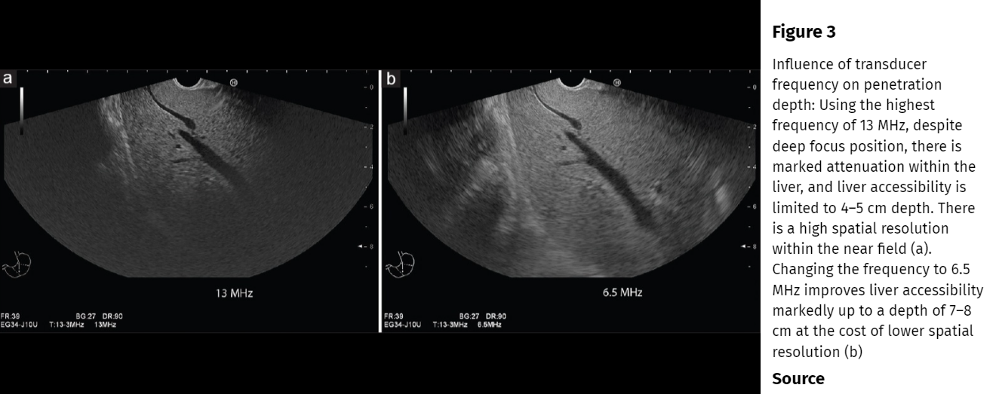

Slide 47
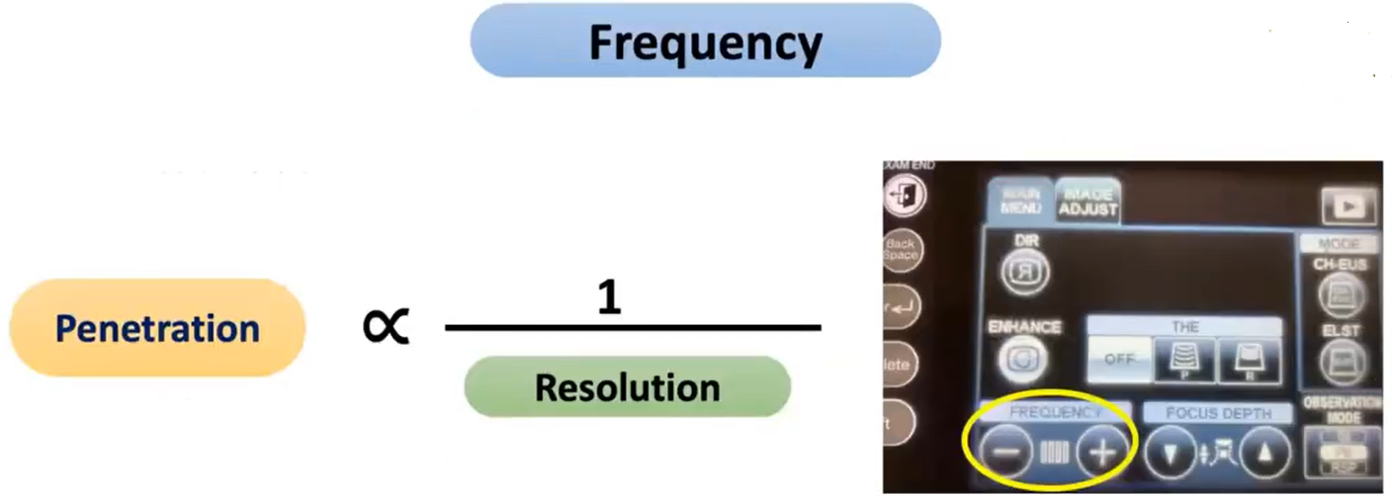

Slide 48
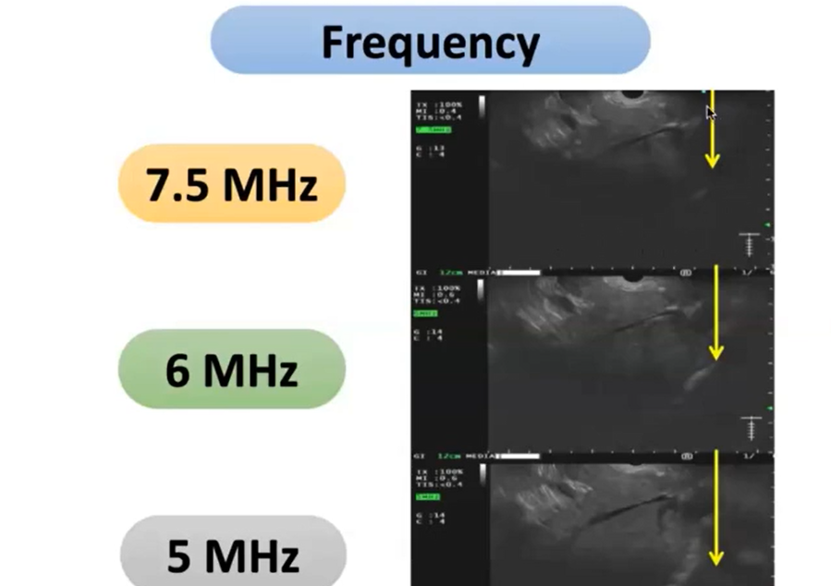

Slide 49
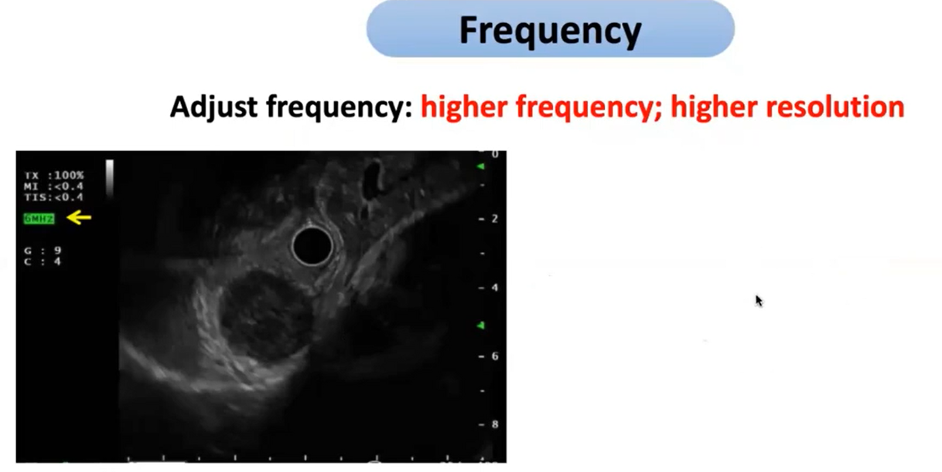

Slide 50
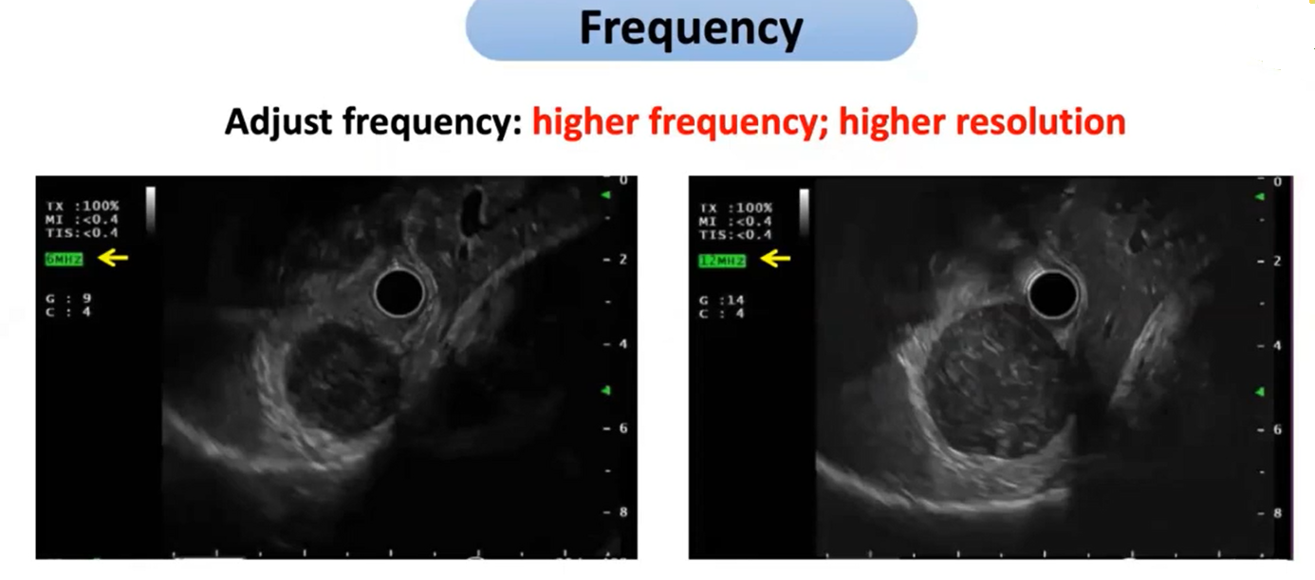

Slide 51
Adjust the ultrasound gain
Proper imaging requires the examiner to adjust the signal gain, which exists for each of the three US modalities (B-mode, color Doppler, and spectral Doppler).

Slide 52
Initially, the operator chooses a B-mode gain of preference. If a Doppler examination is planned, the B-mode gain is kept as low as possible to leave enough pixels for the color flow imaging.

Slide 53
In practice, the user should reduce the ultrasound gain for so long until the vessel lumen, which Doppler examination is planned for, is almost free of internal echoes.

Slide 54
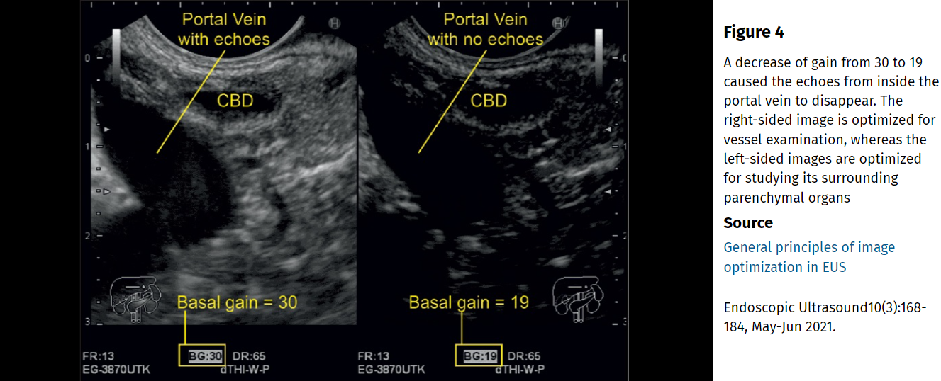

Slide 55
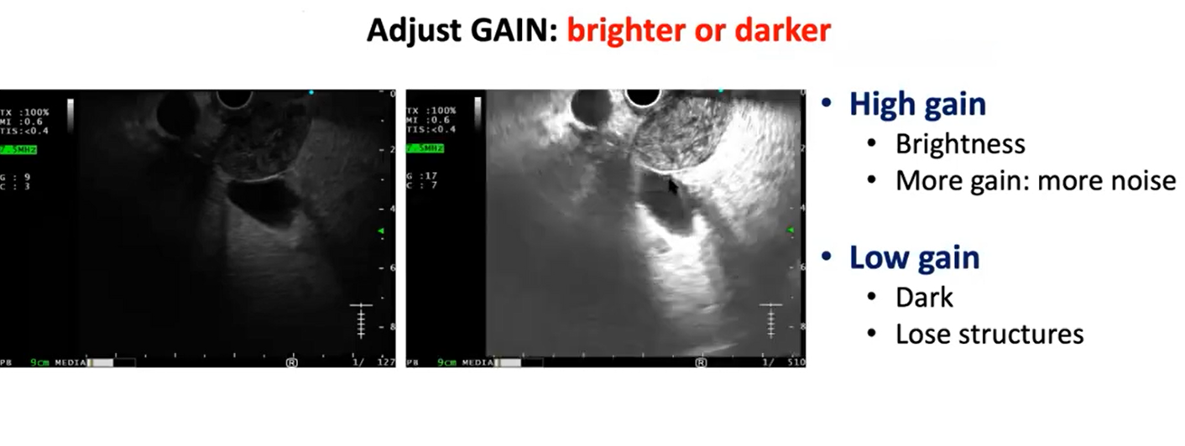

Slide 56
System Gain and Time Gain Compensation
The amplification of the output can be adjusted by the operator in two ways.
One is to increase the overall gain of the system, an approach that uniformly increases the amplitude of all echoes received by the transducer. This can improve the detection of weak echoes; however, it generally comes at the expense of overall resolution.

Slide 57
Current endoscopic ultrasonography (EUS) processors allow the operator to vary the gain by depth.

Slide 58
Adjust the focal zone
The sonographic focus is a point or an area where the best resolution is attained.
The focus depth is usually visualized on the side of the screen as an arrow and can be manually moved up and down to the desired location.

Slide 59
A single focus results in a point of higher lateral resolution than the surrounding field of view.
A dual focus translates into an area of increased lateral resolution. It improves the spatial resolution of the area.
But The frame rate should be maintained above 20 frames per second (FPS) to safeguard a reasonable temporal resolution.

Slide 60
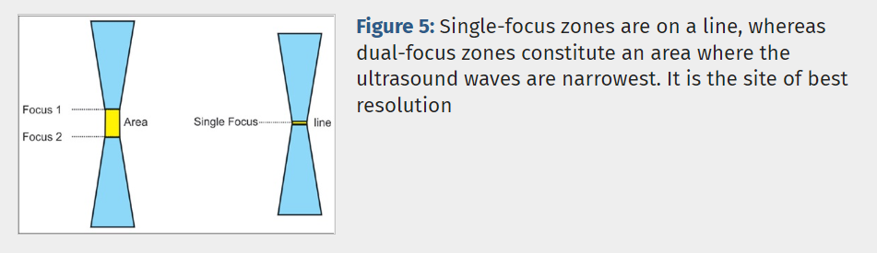

Slide 61
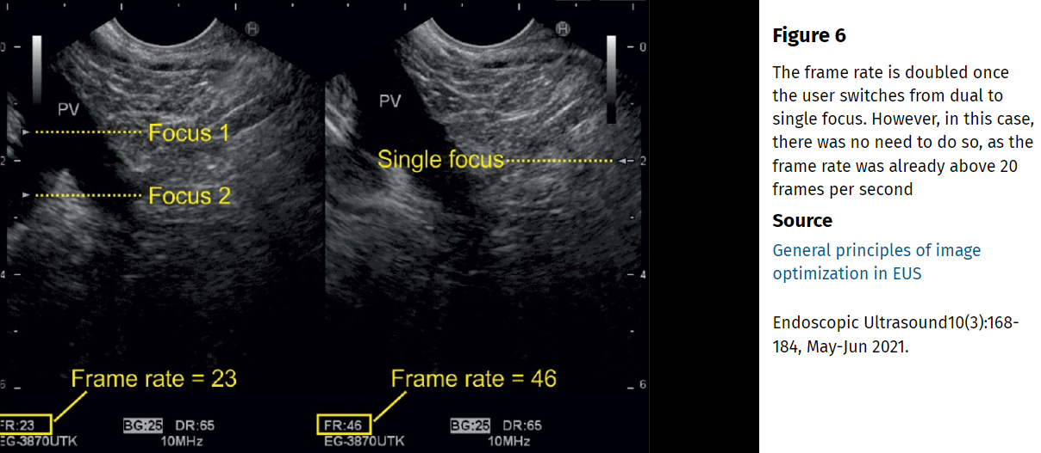

Slide 62
Apply compound imaging
In conventional B-mode sonography, each image is obtained from a single angle of insonation, whereas in “compound imaging,” each sonographic picture is composed of multiple frames.

Slide 63
In “spatial compounding,” multiple coplanar frames are recorded from different angles. The echoes from these multiple acquisitions are processed into a single composite image in real time.

Slide 64
it leads to a better resolution at the central oval region where the frames from all steering angles overlap. There is less improvement of the image quality in the periphery where fewer frames overlap.

Slide 65
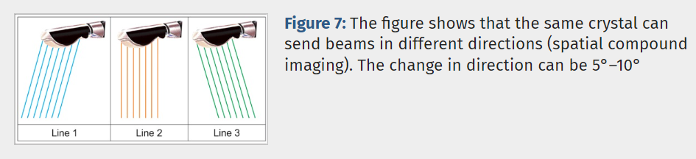

Slide 66
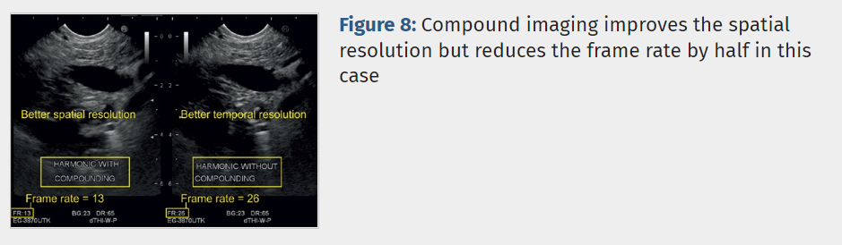

Slide 67
Apply tissue harmonic imaging
transducers transmit waves at a basic frequency. The returning signal contains a mixture of the basic and harmonic frequencies.
Harmonics are positive integral multiples of the fundamental frequency.

Slide 68
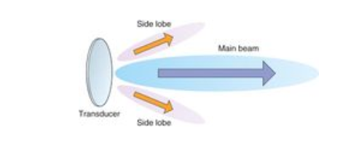
Side Lobe Artifacts

Slide 69
The software of the latest US systems can filter incoming frequencies and render only information from certain harmonics into final pictures, a process called THI, which improves image resolution regarding all its main features.

Slide 70
Harmonics are generated by the interaction of the sound wave with the tissue and they travel only once to reach the probe. Hence, they are associated with less clutter, noise, and artifacts.

Slide 71
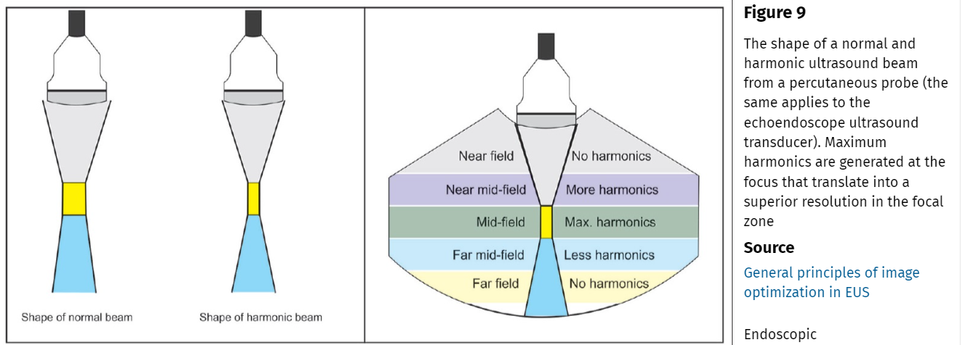

Slide 72
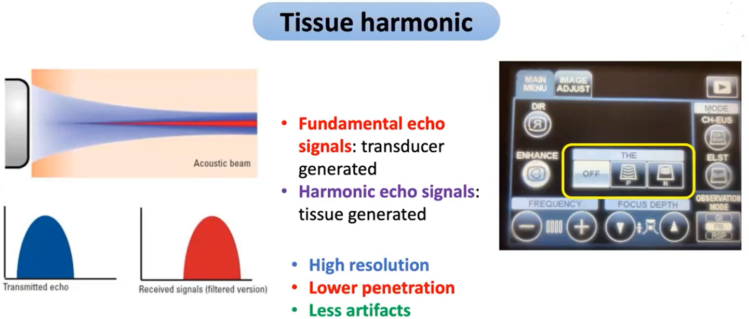

Slide 73
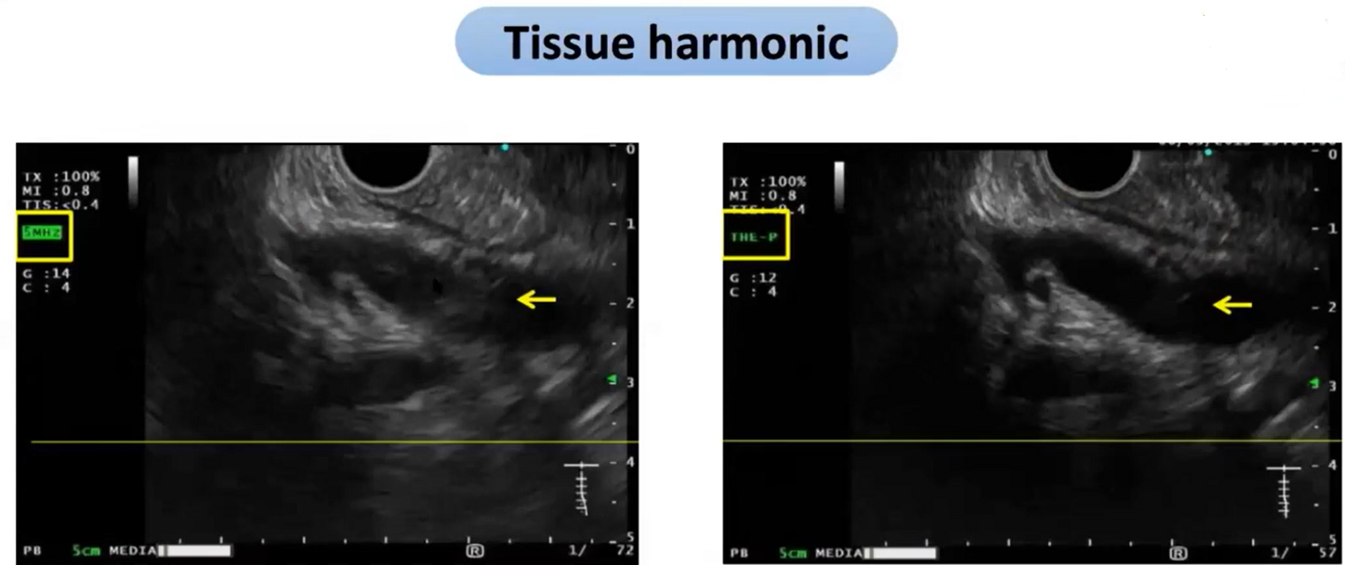

Slide 74
